Slide 1

Project Sunshine
Notes:
Alun screen
Rana

Slide 2
The Team
Principal Agile Project Manager: Rana Alqrenawi
Rachel Chenery
Alun Groome
Myriam Thursch
Notes:
90 seconds each
Rana
Rachel
Myriam
Alun

Slide 3
Project Sunshine Brief
To develop a web app that can advise on the best time and way to maximise sunshine on your daily walking
Client: Zühlke Manchester
Notes:
Rana

Slide 4
Sprint Goals
Data Modeling
APIs
Backend structure and Github repositories
Technical Configurations and new learnings
Notes:
Rana

Slide 5

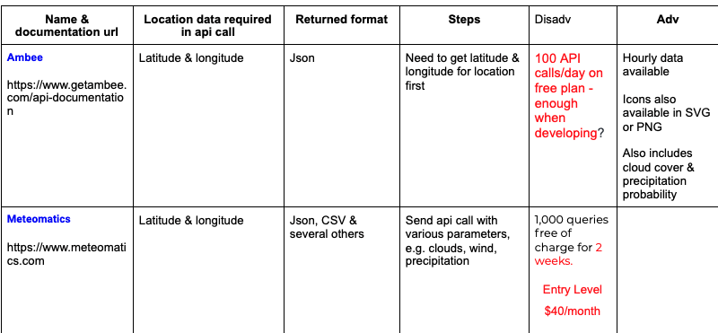






Analysis & Choice of Third Party APIs
Notes:
Rachel:
Three uses:
Location of user
Weather
Maps
For display on Weather Page
For interactive maps to save for walks

Slide 6
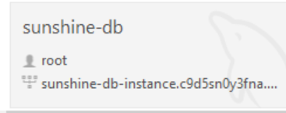
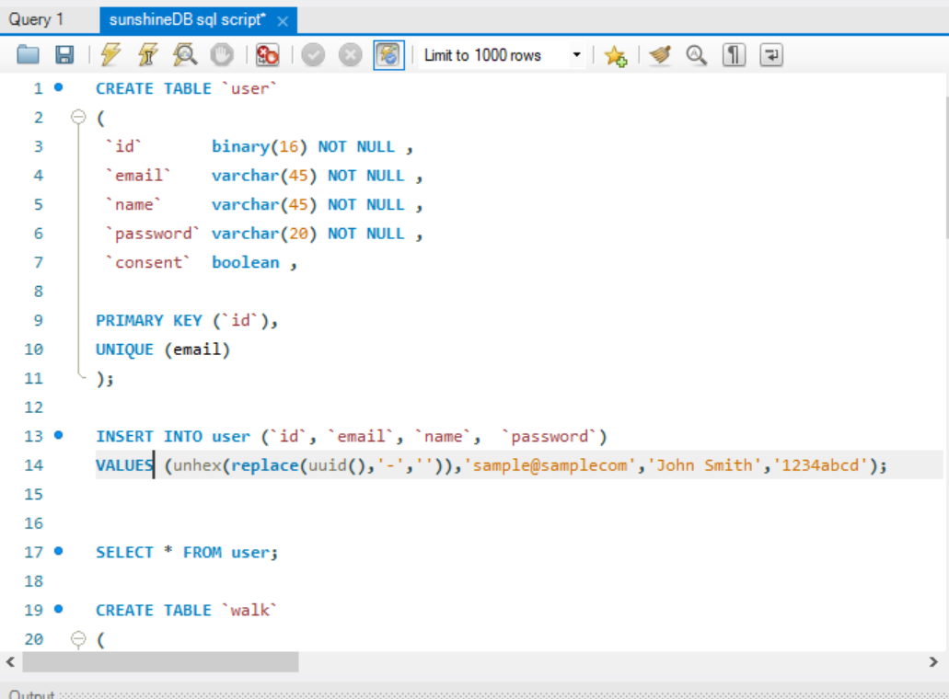
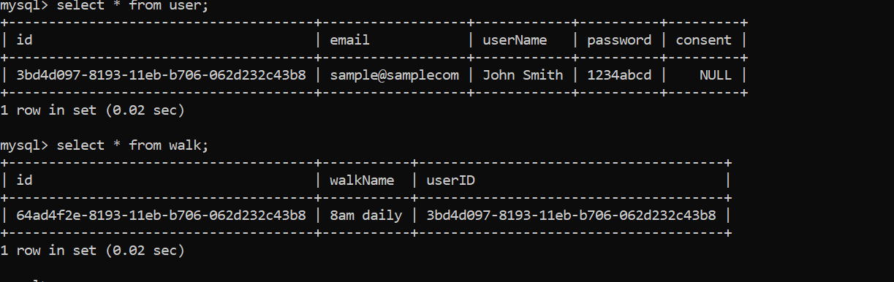
Building the database
Notes:
Myriam

Slide 7
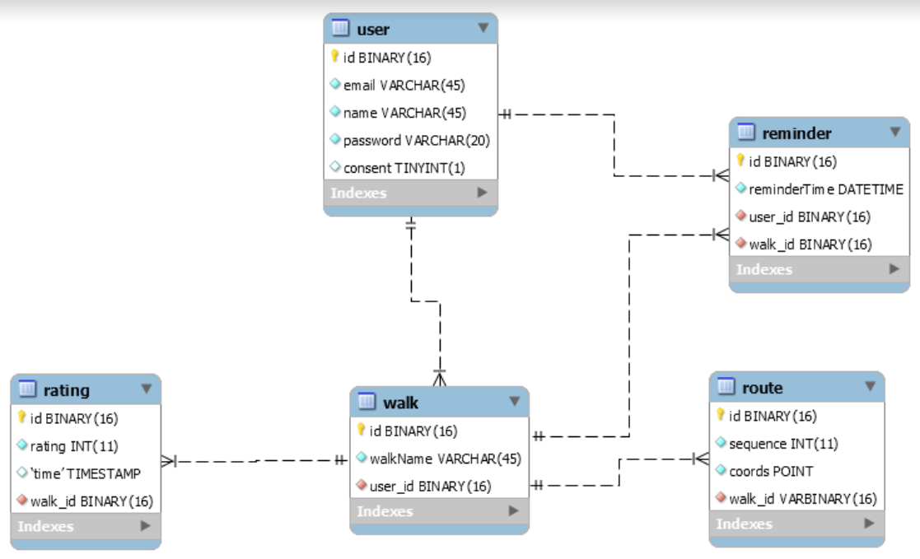
Data Structure and ERD
Notes:
Myriam

Slide 8
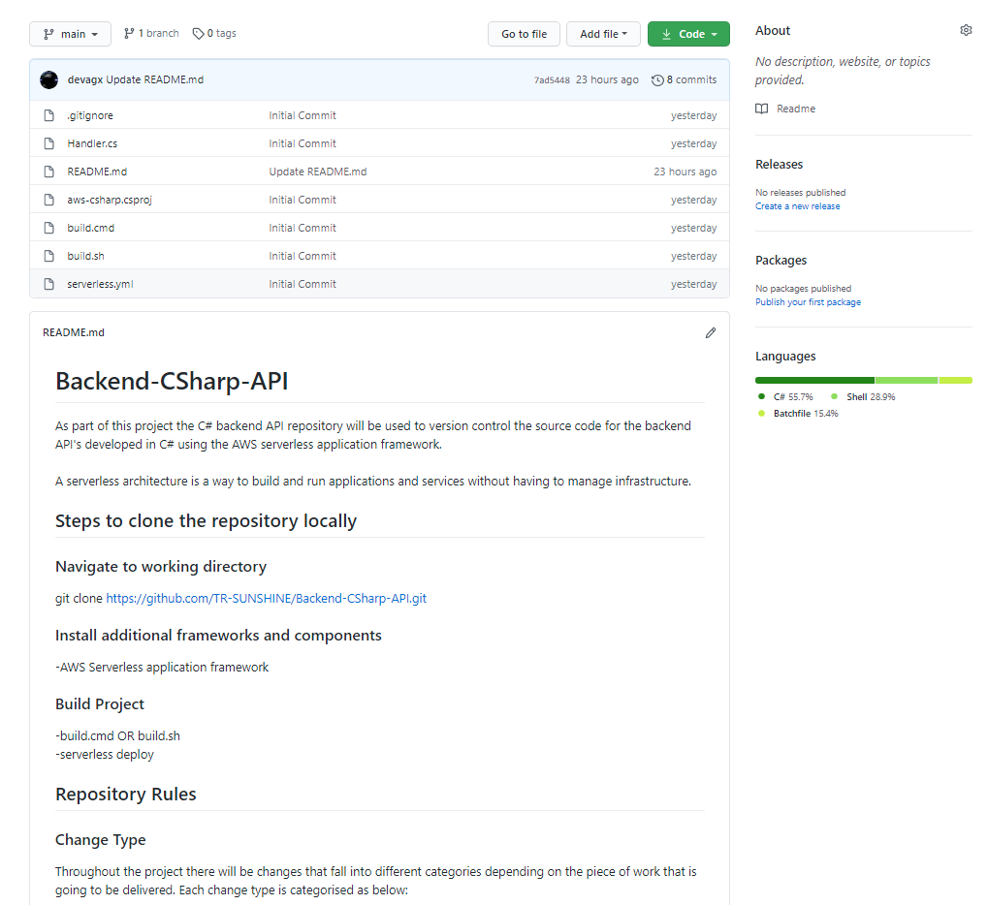
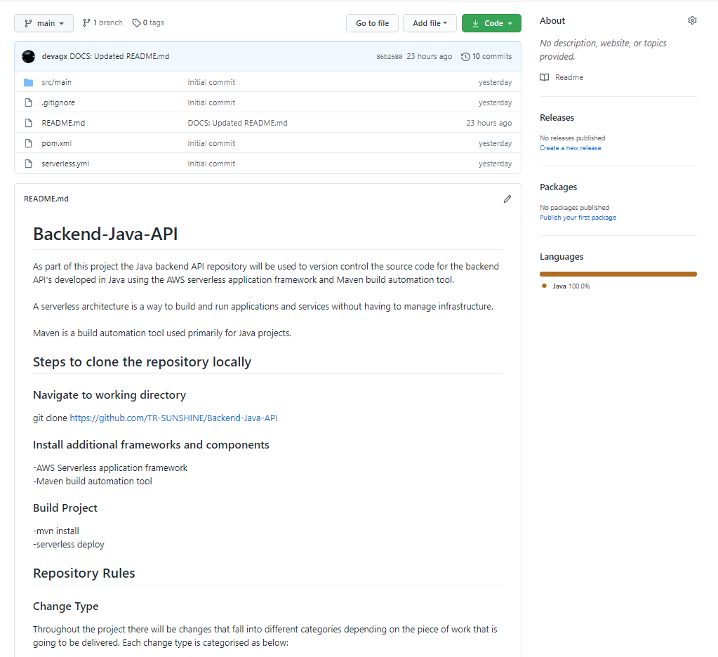
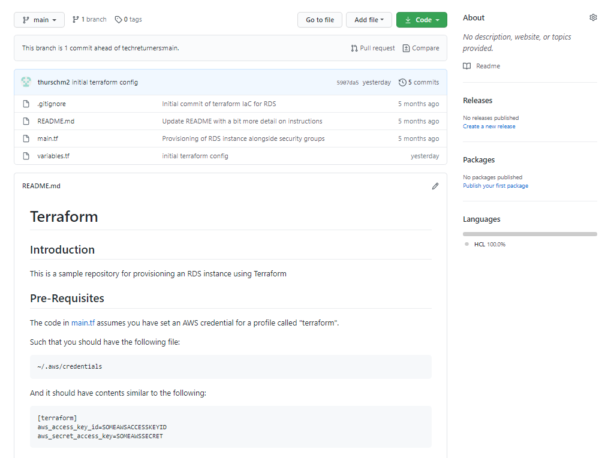
Backend Frameworks and Repositories
C# API Repository
Java API Repository
Terraform Repository
Notes:
Alun

Slide 9






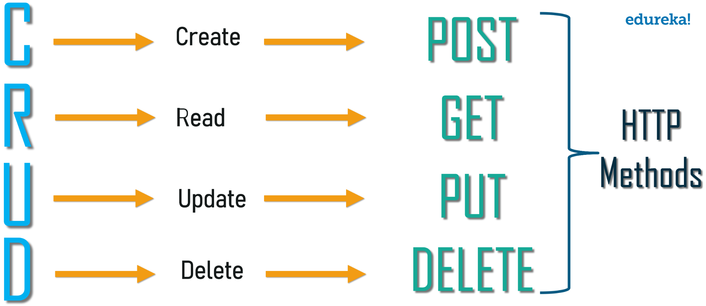


Technology Stack
React
Java Script
ESLint
Java
Maven
C# .NET Core
RESTful Web Services
Swagger UI
Coding Editors
Visual Studio 2019
VS Code
IntelliJ
AWS
Serverless
Lamda
Terraform
MySql
Firebase
Notes:
Alun
Terraform and Serverless
AWS and MySQL

Slide 10
DEMO
Notes:
Alun Machine
Weather Page: API .. Rachel
Individual Walk + Add Walk: Routes and the API .. Alun

Slide 11

Next Sprint
Ongoing Frontend ..
Data Structure ..
Backend ..
Notes:
Myriam

Slide 12

Thanks
for
listening ..
Any
questions?
Notes:
Myriam

